Slide 1
ГБОУ СПО НО «Краснобаковский лесной колледж»
ЦВЕТЫ
Студентки 4курса 3группы
Зориной Юлии
2014 год

Slide 2
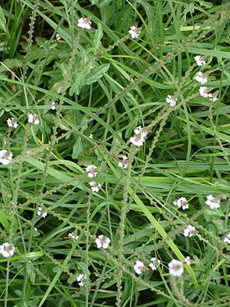
Verbena
The leaves are usually opposite, simple, and in many species hairy, often densely so. The flowers are small, with five petals, and borne in dense spikes. Typically some shade of blue, they may also be white, pink, or purple, especially in cultivars.

Slide 3
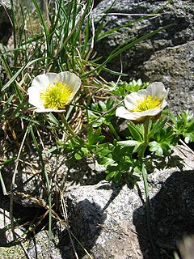
Buttercup
The name Ranunculus is Late Latin for "little frog," from rana "frog" and a diminutive ending. This probably refers to many species being found near water, like frogs.
The name buttercup may derive from a false belief that the plants give butter its characteristic yellow hue (in fact it is poisonous to cows and other livestock). A popular children's game involves holding a buttercup up to the chin; a yellow reflection is supposed to indicate fondness for butter.

Slide 4
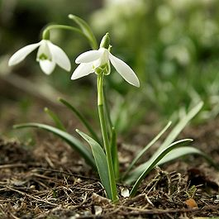
Galanthus
Galanthus (snowdrop; Greek gála "milk", ánthos "flower") is a small genus of about 20 species of bulbous herbaceous plants in the family Amaryllidaceae, subfamily Amaryllidoideae. Most flower in winter, before the vernal equinox (20 or 21 March in the Northern Hemisphere), but certain species flower in early spring and late autumn.
Snowdrops are sometimes confused with the two related genera within Galantheae, snowflakes Leucojum and Acis.

Slide 5
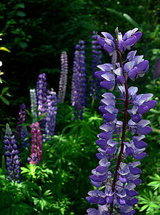
Lupinus
Lupinus, commonly known as lupin or lupine (North America), is a genus of flowering plants in the legume family, Fabaceae. The genus includes over 200 species, with centers of diversity in North and South America. Smaller centers occur in North Africa and theMediterranean.Seeds of various species of lupins have been used as a food for over 3000 years around the Mediterrranean (Gladstones, 1970) and for as much as 6000 years in the Andean highlands (Uauy et al., 1995), but never have they been accorded the same status as soybeans or dry peas and other pulse crops.

Slide 6
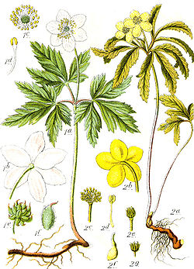
Anemone
According to the Oxford English Dictionary, Greek anemōnē means "daughter of the wind", from ánemos "wind" + feminine patronymic suffix-ōnē. The Metamorphoses of Ovid tells that the plant was created by the goddess Venus when she sprinkled nectar on the blood of her dead lover Adonis. The name "windflower" is used for the whole genus as well as the wood anemone A. nemorosa

Slide 7
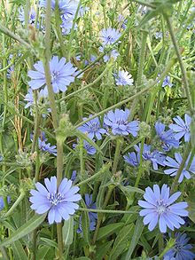
Cichorium
Cichorium is a genus of flowering plants in the family Asteraceae. The species are commonly known as chicory or endive – there are two cultivated species, and four to six wild species.

Slide 8
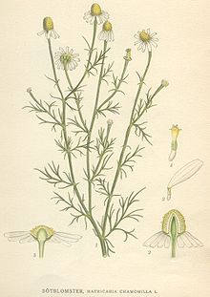
Matricaria
Matricaria is a genus of flowering plants in the sunflower family (Asteraceae). Some of the species have the common name of "mayweed," but this name also refers to plants not in this genus.
Most are very common in the temperate regions of Europe, Asia, and America, as well as in northern and southern Africa, and some are naturalised in Australia. M. occidentalis is native to North America; other species have been introduced there.

Slide 9
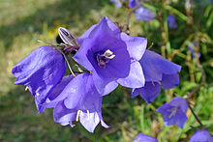
Bellflower
The leaves are alternate and often vary in shape on a single plant, with larger, broader leaves at the base of the stem and smaller, narrower leaves higher up; the leaf margin may be either entire or serrated (sometimes both on the same plant). Many species contain white latex in the leaves and stems

Slide 10
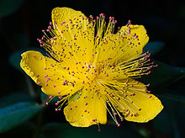
Hypericum
Hypericum /ˌhaɪˈpɪərɨkəm/ is a genus of 490 species of flowering plants in the family Hypericaceae (formerly often considered a subfamily of Clusiaceae). Hypericum is unusual for a genus of its size because a worldwide taxonomic monograph was produced for it byN.Robson (working at the Natural History Museum, London, UK, between 1977 and 2012). Robson recognizes 36 sections within Hypericum.

