Slide 1
ГБОУ СПО НО «КБЛК»
Лекарственные травы
Выполнила студентка
IV курса 2 группы
Слепнева Мария Николаевна
Р.п. Красные Баки
2014 г.

Slide 2
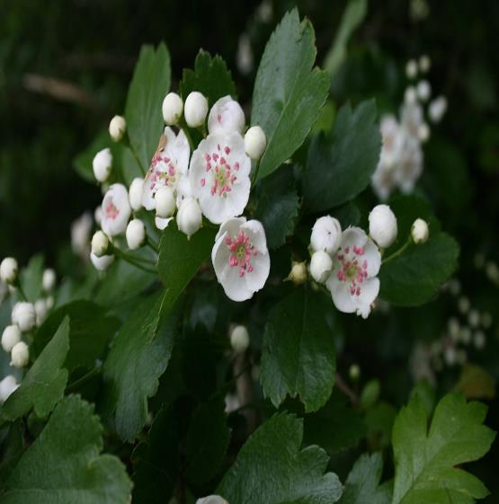
Hawthorn
It is a large shrub or small tree growing to 8 m (rarely to 12 m) tall, with a dense crown. The leaves are 2–6 cm long and 2–5 cm broad, with 2–3 shallow, forward-pointing lobes on each side of the leaf. The hermaphrodite flowers are produced in corymbs of 6–12, each flower with five white or pale pink petals and two or three styles, and are pollinated by midges. The fruit is a dark red pome 6–10 mm diameter, slightly broader than long, containing 2–3 nutlets.

Slide 3
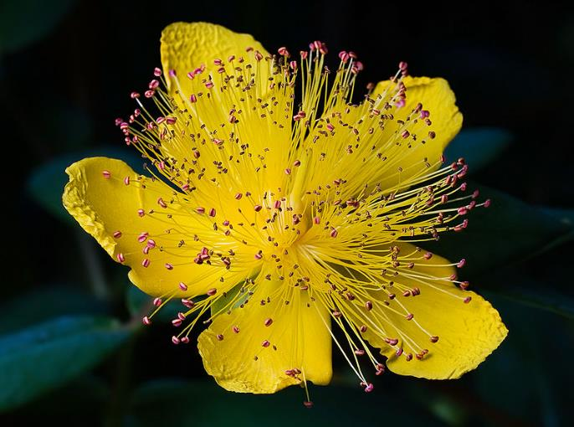
Hypericum
Hypericums vary from herbaceous annual or perennials 5–10 cm tall to shrubs and small trees up to 12 m tall. The leaves are opposite, simple oval, 1–8 cm long, either deciduous or evergreen. The flowers vary from pale to dark yellow, and from 0.5–6 cm in diameter, with five (rarely four) petals, most having prominent stamens.

Slide 4
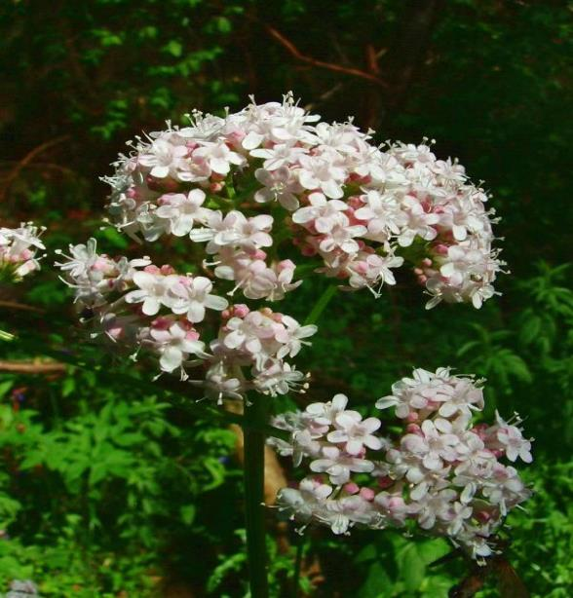
Valerian (plant)
Valerian has been used as a medicinal herb since at least the time of ancient Greece and Rome. Hippocrates described its properties, and Galen later prescribed it as a remedy for insomnia. In medieval Sweden, it was sometimes placed in the wedding clothes of the groom to ward off the "envy" of the elves.In the sixteenth century the Anabaptist reformer Pilgram Marpeck prescribed valerian tea for a sick woman.

Slide 5
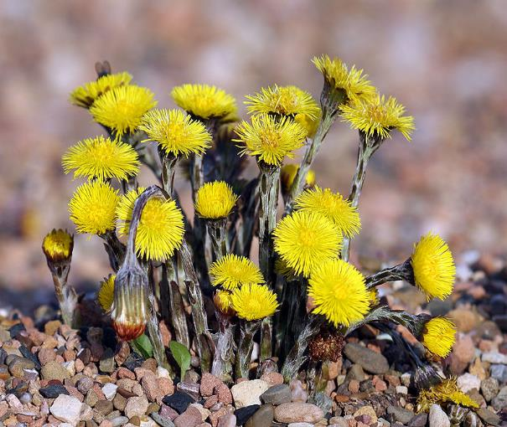
Tussilago
Coltsfoot is a perennial herbaceous plant that spreads by seeds and rhizomes. Tussilago is often found in colonies of dozens of plants. The flowers, which superficially resemble dandelions, appear in early spring before dandelions appear. The leaves, which resemble a colt's foot in cross section, do not appear usually until after the seeds are set. Thus, the flowers appear on stems with no apparent leaves, and the later appearing leaves then wither and die during the season without seeming to set flowers. The plant is typically 10–30 cm in height.

Slide 6
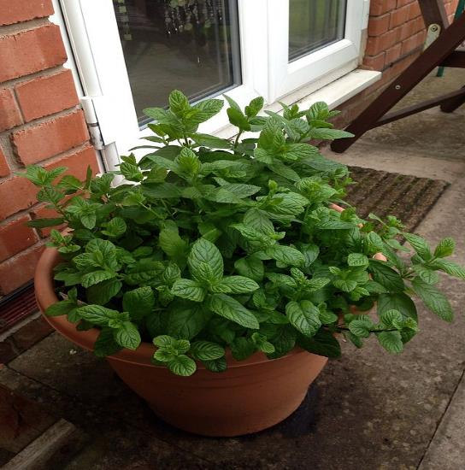
Mint
Mints are aromatic, almost exclusively perennial, rarely annual, herbs. They have wide-spreading underground and overground stolons and erect, square,branched stems. The leaves are arranged in opposite pairs, from oblong to lanceolate, often downy, and with a serrated margin. Leaf colors range from dark green and gray-green to purple, blue, and sometimes pale yellow. The flowers are white to purple and produced in false whorls called verticillasters

Slide 7
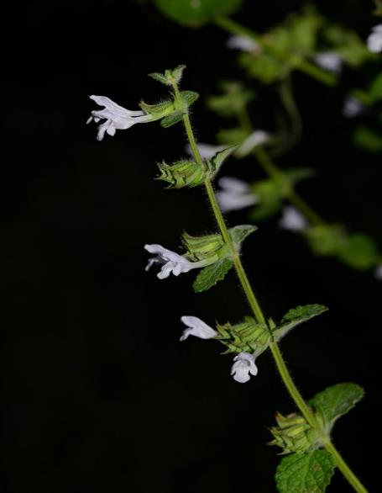
Balm
It grows to 70–150 cm tall. The leaves have a gentle lemon scent, related to mint. During summer, small white flowers full of nectar appear. It is not to be confused with bee balm (which is genus Monarda). The white flowers attract bees, hence the genus name Melissa (Greek for 'honey bee'). Its flavour comes from citronellal (24%), geranial (16%), linalyl acetate (12%) and caryophyllene (12%).

Slide 8
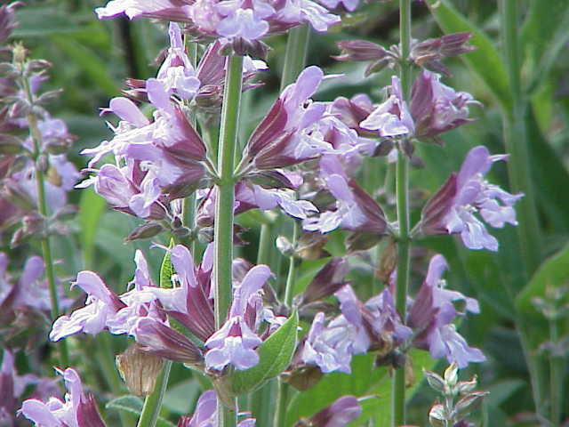
Sage
Salvia is the largest genus of plants in the mint family, Lamiaceae, with nearly 1000 species of shrubs, herbaceous perennials, and annuals. Within the Lamiaceae, Salvia is member of the tribe Mentheae within the subfamily Nepetoideae. It is one of several genera commonly referred to as sage.

Slide 9
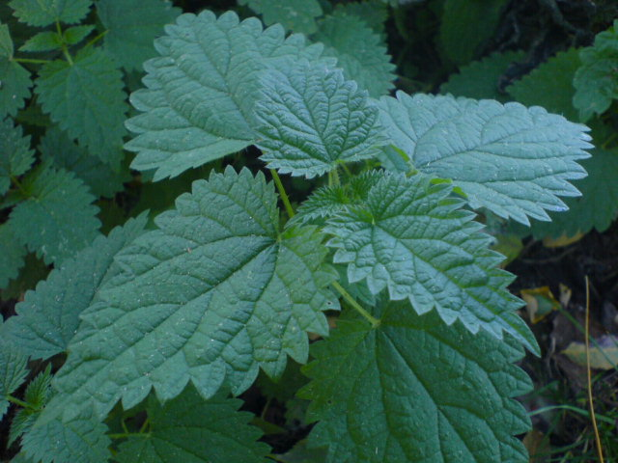
Nettle
Urtica is a genus of flowering plants in the family Urticaceae. Many species have stinging hairs and may be called nettles or stinging nettles, although the latter name applies particularly to Urtica dioica.
Urtica species are food for the caterpillars of numerous Lepidoptera (butterflies and moths), such as the tortrix moth Syricoris lacunana and several Nymphalidae, such as Vanessa atalanta, one of the red admiral butterflies

Slide 10
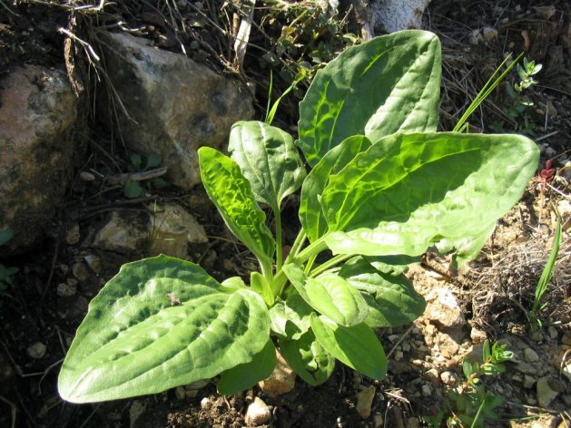
Plantain
Plantago is a genus of about 200 species of small, inconspicuous plants commonly called plantains or fleaworts. They share this name with the very dissimilar plantain, a kind of banana. Most are herbaceous plants, though a few are subshrubs growing to 60 cm (23.5 in) tall. The leaves are sessile, but have a narrow part near the stem which is a pseudo-petiole. They have three or five parallel veins that diverge in the wider part of the leaf. Leaves are broad or narrow, depending on the species.

