Slide 1
ГБОУ СПО НО « КБЛК»
Ягоды
Выполнила студентка
4курса 2группы
Цыганова Оля. В.
Пгт. Красные Баки 2014год

Slide 2
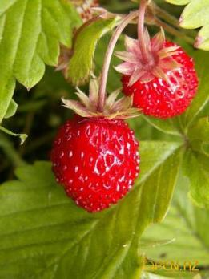
Strawberrie
Fragaria /frəˈɡɛəriə/^{[2]} is a genus of flowering plants in the rose family, Rosaceae, commonly known as strawberries for their edible fruits. There are more than 20 described species and many hybrids and cultivars. The most common strawberries grown commercially are cultivars of the garden strawberry, a hybrid known as Fragaria × ananassa. Strawberries have a taste that varies by cultivar, and ranges from quite sweet to rather tart. Strawberries are an important commercial fruit crop, widely grown in all temperate regions of the world.

Slide 3
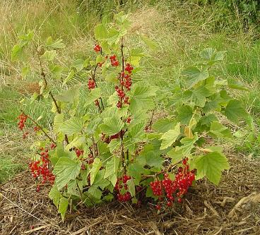
Redcurrant
The redcurrant (or red currant), Ribes rubrum, is a member of the genus Ribes in the gooseberry family Grossulariaceae, native to parts of western Europe (Belgium, France, Norway, Sweden, Germany, Netherlands, northern Italy, northern Spain, Portugal and Poland

Slide 4
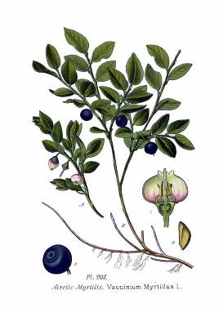
Bilberry
Vaccinium myrtillus is a species of shrub with edible fruit of blue color, commonly called "bilberry", "whortleberry" or European blueberry. It has much in common with the American blueberry (Vaccinium cyanococcus). It is more precisely called common bilberry or blue whortleberry, to distinguish it from other Vaccinium relatives. Regional names include blaeberry, hurtleberry,^{[2]} huckleberry, winberry and fraughan.[

Slide 5
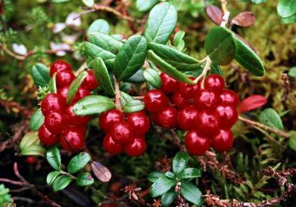
Cowberry
cowberry is a short evergreen shrub in the heath family that bears edible fruit, native to boreal forest and Arctic tundra throughout the Northern Hemisphere from Eurasia to North America. Lingonberries are a staple in Northern Scandinavia, picked in the wild and used to accompany a variety of dishes.

Slide 6
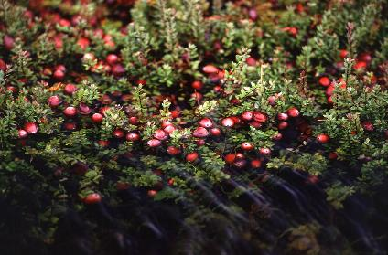
Cranberry
Cranberries are a group of evergreen dwarf shrubs or trailing vines in the subgenus Oxycoccus of the genus Vaccinium. Cranberry may also be the common name of the species Vaccinium oxycoccos, particularly in Britain. In some methods of classification, Oxycoccus is regarded as a genus in its own right. They can be found in acidic bogs throughout the cooler regions of the northern hemisphere..

Slide 7
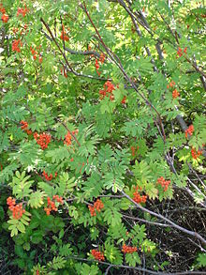
Mountain-ash
The exact number of species is disputed depending on the circumscription of the genus, and also due to the number of apomictic microspecies, which some treat as distinct species but others group in a smaller number of variable species. Recent treatments treat Sorbus in a narrower sense to include only the leaved species of Sorbus, raising several of the other subgenera to generic rank.

Slide 8
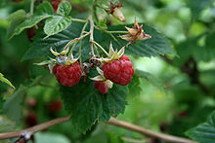
Raspberry
raspberry or occasionally as European raspberry to distinguish it from other raspberries) is a red-fruited species of Rubus native to Europe and northern Asia and commonly cultivated in other temperate regions. A closely related plant in North America, sometimes regarded as the variety Rubus idaeus var. strigosus, is more commonly treated as a distinct species, Rubus strigosus (American Red Raspberry), as is done here.

Slide 9
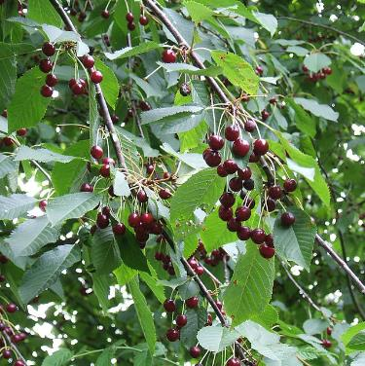
Sweet cherry
sweet cherry, bird cherry,or gean,[is a species of cherry native to Europe, Anatolia, Maghreb, and western Asia, from the British Isles^{[3]} south to Morocco and Tunisia, north to the Trondheimsfjord region in Norway and east to the Caucasus and northern Iran, with a small disjunct population in the western Himalaya.[This species, in the rose family (Rosaceae), has a diploid set of sixteen chromosomes

Slide 10
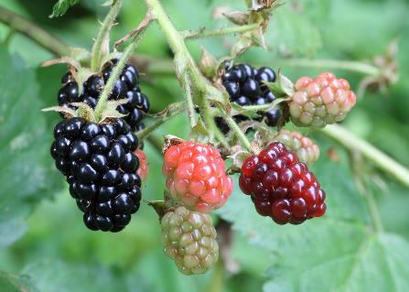
Blackberry
The blackberry is an edible fruit produced by many species in the Rubus genus in the Rosaceae family, hybrids among these species within the Rubus subgenus, and hybrids between the Rubus and Idaeobatus subgenera.

